Slide 1

Introduction to R/tidyverse
Sara Locatelli, PhD
Data Analyst
American Board of Medical Specialties

Slide 2
What is R?
The name of a programming language for analysis
Created in 1993
Grew out S (developed by researchers at Bell Labs)
An interpreted language (with features of object-oriented and functional programming)
An open source statistical program that uses this language

Slide 3
What is R?
Maintained by the R Development Core Team of the R Foundation, a non-profit
Open source under the GNU General Public License
What does this mean?
Source code must be made freely available
In many cases, this also means the software is available free (as is the case with R)

Slide 4
Getting Started
Download R (https://cran.r-project.org/)
Click Download R for [your operating system] then select base
Download RStudio (https://rstudio.com/products/rstudio/download/#download)
Select the version for your operating system
Install R then Rstudio
Now – open RStudio and you’ll see this…

Slide 5
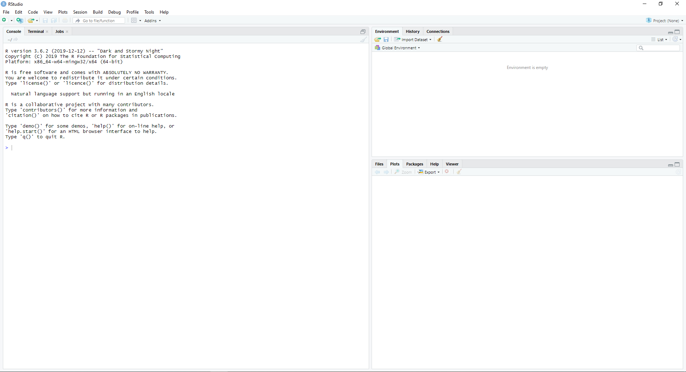

Slide 6
Fun fact: R version names are Peanuts references. This one refers to Snoopy’s novel-writing attempts; other version names include “Kite-Eating Tree” and “Great Pumpkin”
Your R installation is running here

Slide 7
Objects (datasets you load, lists you create, etc.) will show up here in Environment. If you click on the History tab, you’ll see previous code you’ve entered into the console

Slide 8
This multi-purpose quadrant lets you view files/folders, plots you create, packages installed, and help files

Slide 9
Don’t worry – we’re about to write some code!
But first…

Slide 10
What Are Packages?
Packages (or libraries) contain the things you need to work with data in R
Functions to manipulate variables, objects, etc.
Sample datasets
Help files
And so on
R comes with many packages already, such as stats, which includes many descriptive or inferential statistical analyses, as well as functions to read in and visualize data

Slide 11

What is tidyverse?
A set of R packages for data science
Read in data in various forms
Manipulate data
Visualize data
Perform some higher-level programming
They share a common grammar and philosophy

Slide 12
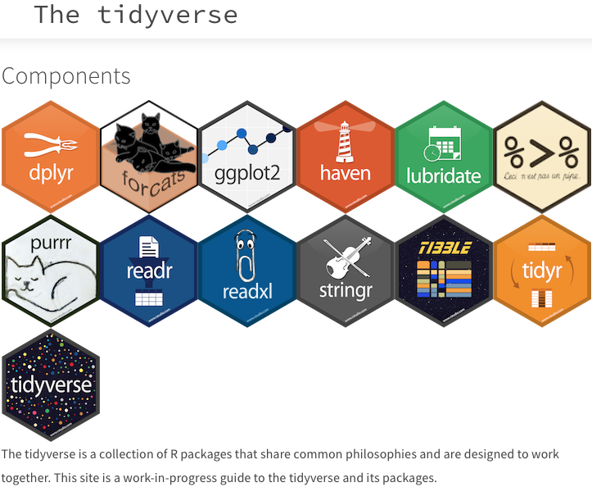

Slide 13
tidyverse Philosophy
Data should be “tidy”
Each row is an observation
Each column is a variable
Each cell contains only one value
The tidyverse helps you tidy “untidy” data (such as cells that contain multiple values or unstructured data, like text from websites) as well as work with tidy data

Slide 14
Time to write your first code!
Go back to RStudio and type this…

Slide 15
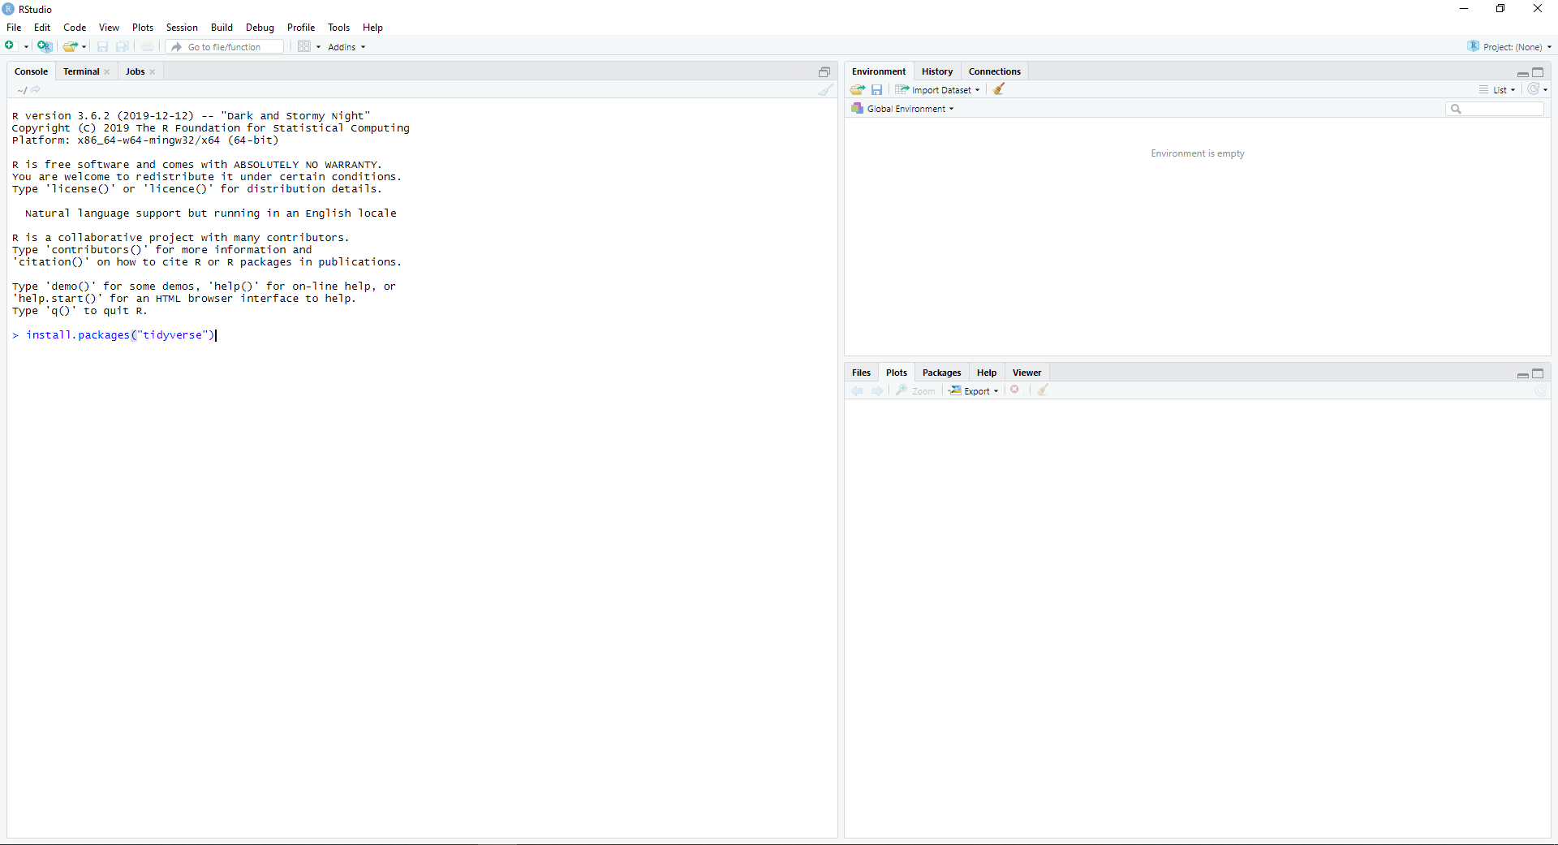
install.packages(“tidyverse”)
Then press Enter

Slide 16
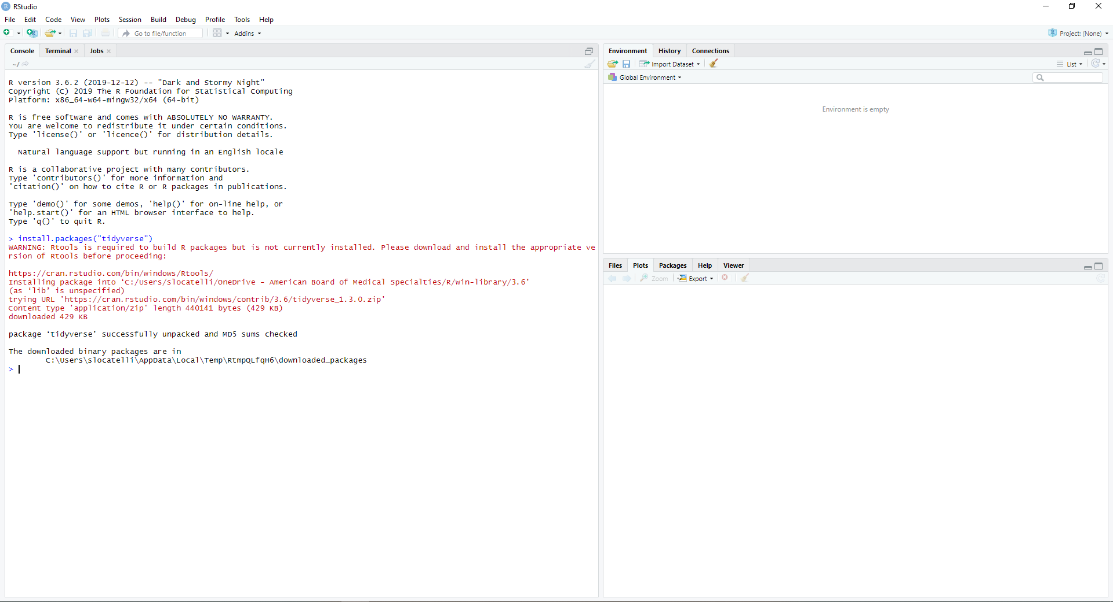
You’ve now installed tidyverse!

Slide 17
Some R Basics
Create objects as:
name <- followed by your function
For example, what do you think this code does?
mydata <- read_csv(“file.csv”, col_names = TRUE)

Slide 18
Some R Basics
Names are case-sensitive:
Mydata, myData, and MYDATA are different. If I used some version of these after I created mydata from the previous slide, I’d get an error message that the object doesn’t exist.

Slide 19
Some R Basics
You’ll need to load libraries before you can use their functions
And you’ll need to install those packages like you did tidyverse
In RStudio, type the following into the console
library(tidyverse)

Slide 20
Some R Basics
Each function has attributes – pieces of information you provide
Some are required – for example, the file name in the read_csv function
Some are optional – for example, the col_names = TRUE part of read_csv
RStudio will give you some pop-up information as you write the function, and you can find out the exact attributes by checking help
In RStudio, type the following into the console
?read_csv

Slide 21
Some R Basics
There are different kinds of variables, such as
Character
Numeric
Date
Factor
We’ll talk more about this and how to change variable types later

Slide 22
Some R Basics
You can type code directly into the console (as we have so far) OR
You can create and save R scripts

Slide 23
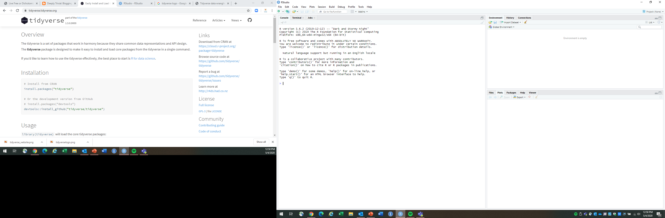
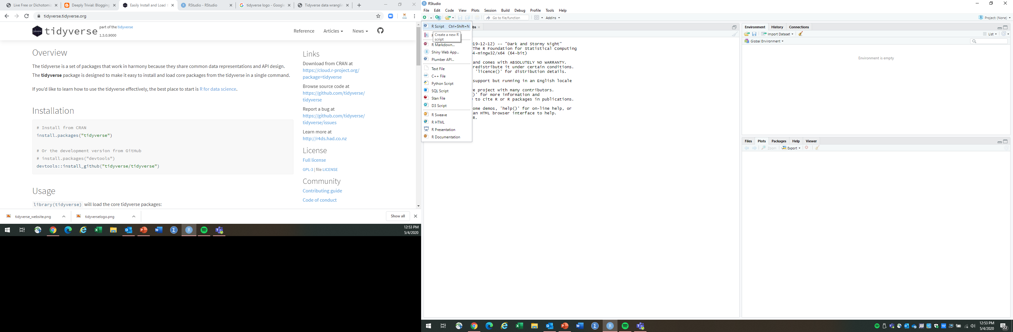
Click here
Then here

Slide 24
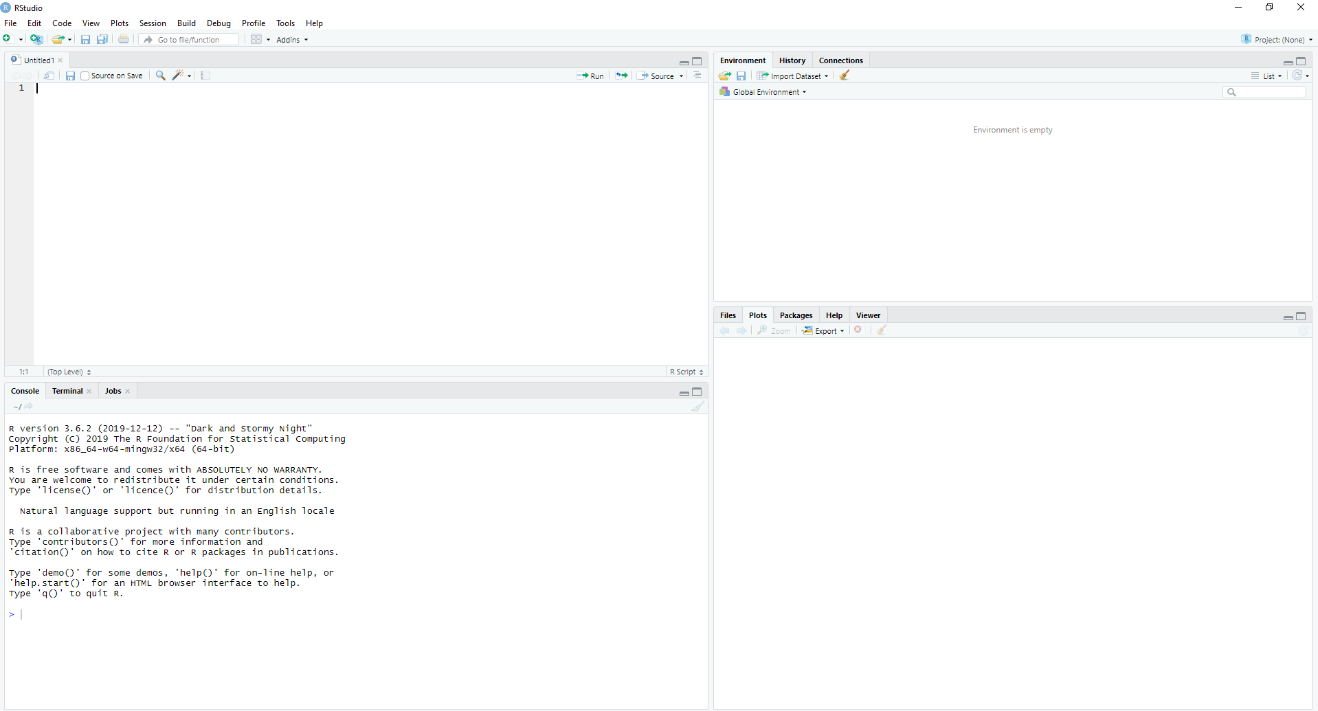
You can now type (and save) your code in this document. To run code, you highlight the code you want, then click Run – this sends that code to the console below.

Slide 25
Enough background
Let’s write some code!

Slide 26
Three Things I Always Start My Code With
Set working directory
R uses forward slashes (/), so if you copy and paste a Windows directory, you’ll need to replace the back slashes (\) – for example:
setwd(“~/My Documents”)
Load tidyverse
library(tidyverse)
Suppress scientific notation (just personal preference)
options(scipen = 999)

Slide 27
Let’s Start Working With Data
Download this file: https://www.dropbox.com/s/umnsozr58wa9iae/UFOsightings.csv?dl=1
This dataset contains UFO sightings reported to the National UFO Reporting Center (NUFORC)

Slide 28
UFO Sightings
Column | Description
datetime | Date and Time of sighting
city | City
state | Abbreviated state, territory, or province (US and Canada only)
country | Abbreviated country
shape | One or two word description of shape
duration (seconds) | Numeric column of duration of sighting in seconds
duration (hours/min) | Character column of time according to witness
comments | Description of the event
date posted | Date this was reported to NUFORC
latitude | Approximate latitude
longitude | and longitude of sighting

Slide 29
Write Your Code!
Set your working directory to where you saved the UFO sightings file
Load tidyverse
If you’d like, suppress scientific notation
Read in the UFO dataset (name your data object whatever you’d like)
My code is on the next slide, but see how much of this you can write on your own!

Slide 30
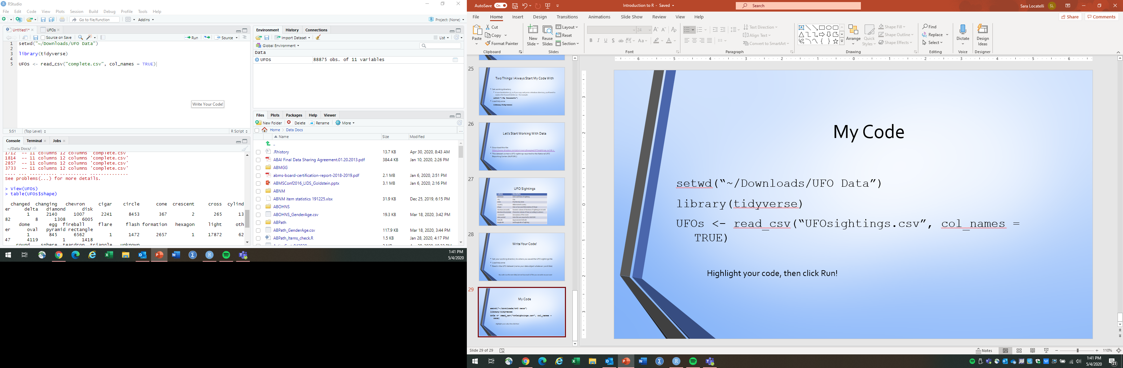
My Code
setwd(“~/Downloads/UFO Data”)
library(tidyverse)
options(scipen = 999)
UFOs <- read_csv(“UFOsightings.csv”, col_names = TRUE)
Highlight your code, then click

Slide 31
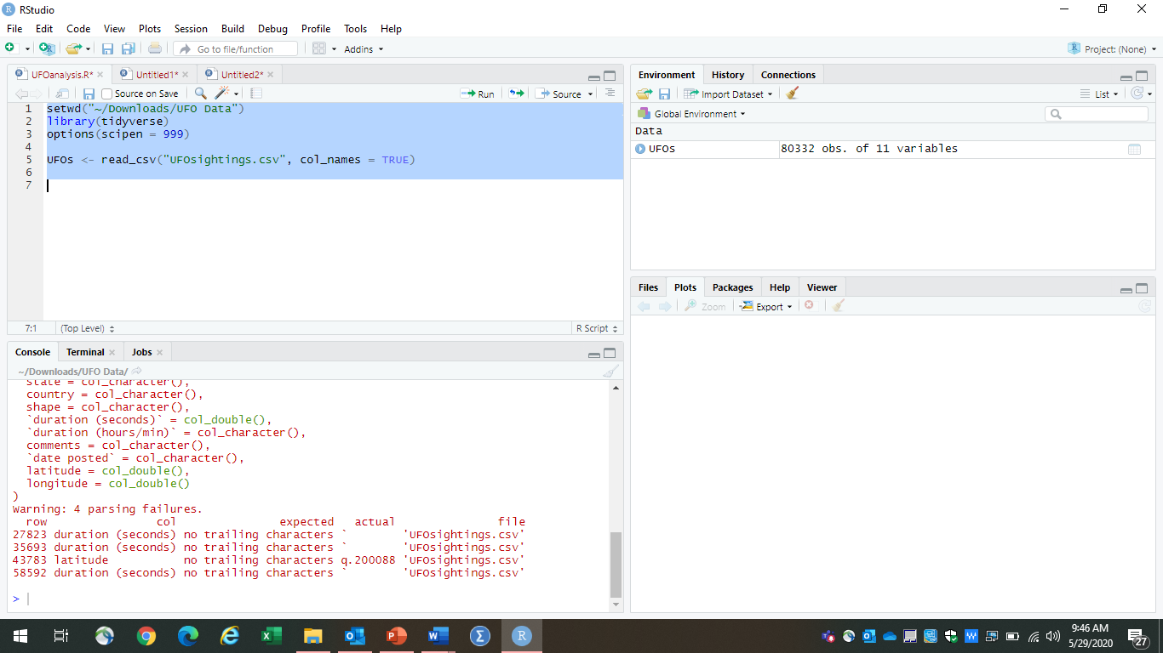
R has now created a dataset called UFOs, containing the data from the CSV file. This is a temporary dataset saved in memory (RAM).

Slide 32
Creating Tables
Though we’ll be using tidyverse for most of this intro, I want to introduce a base R function – table
This generates a frequency table for a variable
The code looks like
table(data$variable)
Using this code as a starting point, can you tell me what UFO shapes are represented in the data?
Once you’ve figured that out, try generating tables of other variables. What happens when you try to create a table of one of the duration variables?

Slide 33
Some Notes
When variable names have a space or symbols in them, you need to enclose the name in `` (the key below Escape)
table(UFOs$`duration (seconds)`)
Missing values are NA
These are omitted from tables, unless you request that they be included
table(UFOs$state, useNA = “ifany”)

Slide 34
Let’s Use More tidyverse Functions
One of the great things about tidyverse is the main pipe, which looks like this:
%>%
This pipe lets you do multiple functions to the same dataset at once but you can use it even if you’re only applying a single function (I do)

Slide 35
Filtering Data
Okay, let’s start working with the data!
How about we create a dataset that only contains the US sightings?
To do that, we need to filter

Slide 36
tidyverse Code, Part 1
Much of your tidyverse code will start with something like this:
UFOs <- UFOs %>%
What this does is tell R to save a dataset called UFOs, using the existing dataset called UFOs, and that the code following the pipe will tell what the new version of UFOs will look like. Because the “new” dataset has the same name as the existing, it will overwrite the original version in memory. (NOTE: It will NOT change the file saved on your computer.) If you don’t want to overwrite, change the first dataset name.

Slide 37
Filtering
The next part of the code will use the function filter()
Within the parentheses would go the logical test(s) to be included in the filtered dataset
For example: variable == “value” (note the double equal sign) or variable > value
What would the logical test for country equal to the United States look like for our data?

Slide 38
Let’s Put the Two Pieces Together
I don’t want to lose my complete UFO file in memory, because I may come back to it later, so I’m going to create a separate version with just US data. (This is just my preference; there’s no wrong answer, because you can always reload the UFO sightings CSV into R again.)
Here’s what my code would look like:
US_UFO <- UFOs %>%
filter(country == "us")

Slide 39
Filtering Exercise
You can include more than one logical test, with & (for “and”) or | (for “or”). Each logical test should include the variable name and test value. For example, if we wanted both US and Canada sightings:
filter(country == “us” | country == “ca”)
What would my code look like if I wanted a dataset, based on the complete UFO dataset, containing sightings with shape “light” that had a duration of at least 3 minutes? How many cases will that give me?

Slide 40
My Code
UFOs1 <- UFOs %>%
filter(shape == "light" & `duration (seconds)` >= 180)
This gives me a dataset with 9,160 cases

Slide 41
Creating and Changing Variables
The tidyverse function to create or change variables is mutate
Let’s create a variable for duration of the event in minutes (and let’s call it “minutes”)
Before writing code, think about what variable we’d need and what math that would involve

Slide 42
Creating and Changing Variables
It would look like this:
minutes = `duration (seconds)`/60
Now put that equation within the parentheses of mutate()
Finally, put the “Part 1” code before it

Slide 43
My Code
UFOs <- UFOs %>%
mutate(minutes = `duration (seconds)`/60)

Slide 44
Visualizing Data
The tidyverse package that helps with visualizing data is ggplot2
The “gg” stands for “grammar of graphics”
When you create a plot with tidyverse, it’s called a “ggplot” (and this is the function you start with)

Slide 45
A Slight Change to Part 1
You don’t have to create/alter a dataset in Part 1
Instead, you can simply reference the dataset you want to use, followed by the main pipe
UFOs %>%
I use this form when visualizing data

Slide 46
ggplot Code – Breaking It Down
ggplot(aes(variable1,variable2))
Short for “aesthetics” – which are the variable(s) that go into the plot

Slide 47
ggplot Code – Breaking It Down
ggplot(aes(variable1,variable2))
Your ggplot requires at least one variable

Slide 48
ggplot Code – Breaking It Down
After the ggplot function and aesthetics, add a + sign
After the +, we need to tell R what kind of plot to create with a “geom_” function

Slide 49
Some Useful “geom_”s
Always include these parentheses; they’ll often be empty (not always), but they’re required
geom_bar(): Bar chart, where you specify one variable (x – should be categories) and ggplot generates counts of values for y
geom_col(): Column chart; bar chart used when you already have counts in your dataset
geom_boxplot(): Box and whiskers plot; specify x (categories) and y (continuous)
geom_histogram(): Histogram; you specify one variable (continuous) and ggplot “bins” your data to create a frequency distribution
geom_point(): Scatterplot; specify both x and y to plot corresponding points (both numeric variables)

Slide 50
Bar Chart with UFO Data
UFOs %>%
ggplot(aes(country)) +
geom_bar()

Slide 51
This dataset needs some cleaning before we can do much more visualization, so we’ll come back to this next time.
But before we end today’s session, let’s talk about one last tidyverse function

Slide 52
Summarizing Data
Mutate creates new or alters existing variables in a dataset
It does not change the number of observations
Summarize works like mutate but it aggregates data

Slide 53
Useful Functions for Summarizing Data
n(): counts observations
n_distinct(): counts distinct values in a variable
Descriptive statistics like mean, median, min, max, sd

Slide 54
Summarize the UFO Set
Let’s generate some summary data for the UFO dataset (just display, don’t save a new dataset)
How many different shapes are represented in the data?
What is the min, max, and median duration time in minutes?

Slide 55
My Code
UFOs %>%
summarise(shapes = n_distinct(shape),
min_time = min(minutes),
med_time = median(minutes),
max_time = max(minutes))

Slide 56
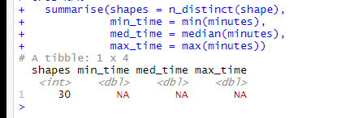
Oh No! What Happened?

Slide 57
We Have Missing Values
Those descriptive statistics functions are from base R and don’t automatically ignore NAs
There are 2 ways we can get rid of them
Add na.rm = TRUE to each descriptive stat statement
Filter our dataset to remove NA values

Slide 58
Filtering and Summarizing at the Same Time
This is why the main pipe is so useful
You can combine multiple data functions in a single set of code; just separate functions with another main pipe
UFOs %>%
filter(minutes != ‘NA’) %>%
summarise(shapes = n_distinct(shape),
min_time = min(minutes),
med_time = median(minutes),
max_time = max(minutes))

Slide 59
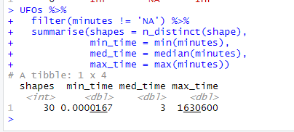
Much Better!

Slide 60

Next Session
These data need cleaning!
Summarizing
Filtering
Visualizing

Slide 61
In the Meantime
Play around with the code you’ve learned and the UFO dataset
It’s okay if you get errors! You won’t hurt anything.
Plus doing things wrong is a great way to learn how the code works and figure out the answer.
Check out help files if you get stuck
You can also google search what you’re trying to do or any error messages you receive
You’ll likely find an answer, often on places like Stack Overflow or R blogs

Slide 62

Shameless Self-Promotion
I regularly blog about R and demonstrate R code, including a lot of tidyverse
http://www.deeplytrivial.com

